Slide 1
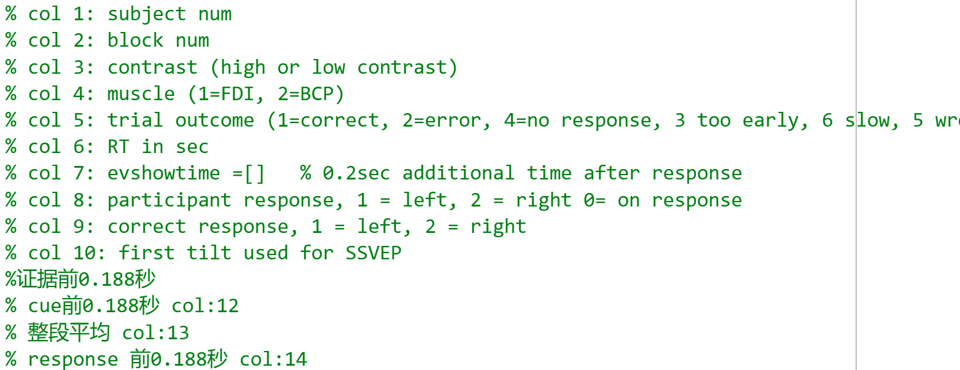
All analysis Exclude invalided trials when too early and wrong muscle CPP channel: 19

Slide 2

SL pre-cue -188ms (CW / HL) SL pre-evidence -188ms (FB)
Correct vs wrong
FDI vs BCP
High vs Low

Slide 3
Correct Vs wrong(SL_b)
Drift rate different since ‘evidence on’
After response amplitude drops faster
Lowest at response time
(from scalp plots) correct have clearer CPP burst around 300-900 than wrong
(from scalp plots) same amplitude; but correct CPP moves more to centre from 300-900
Notes:
EEG_sorting_plot_SL_b.m

Slide 4
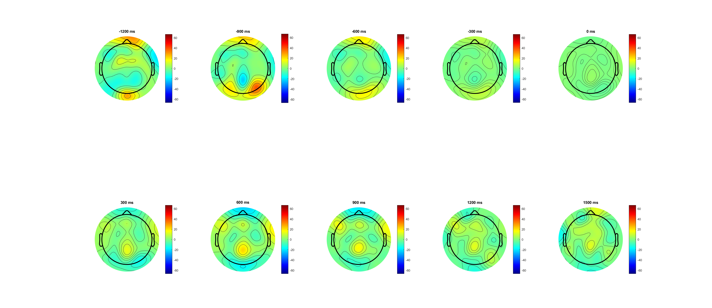
Correct (-1200:1500) pre evd

Slide 5
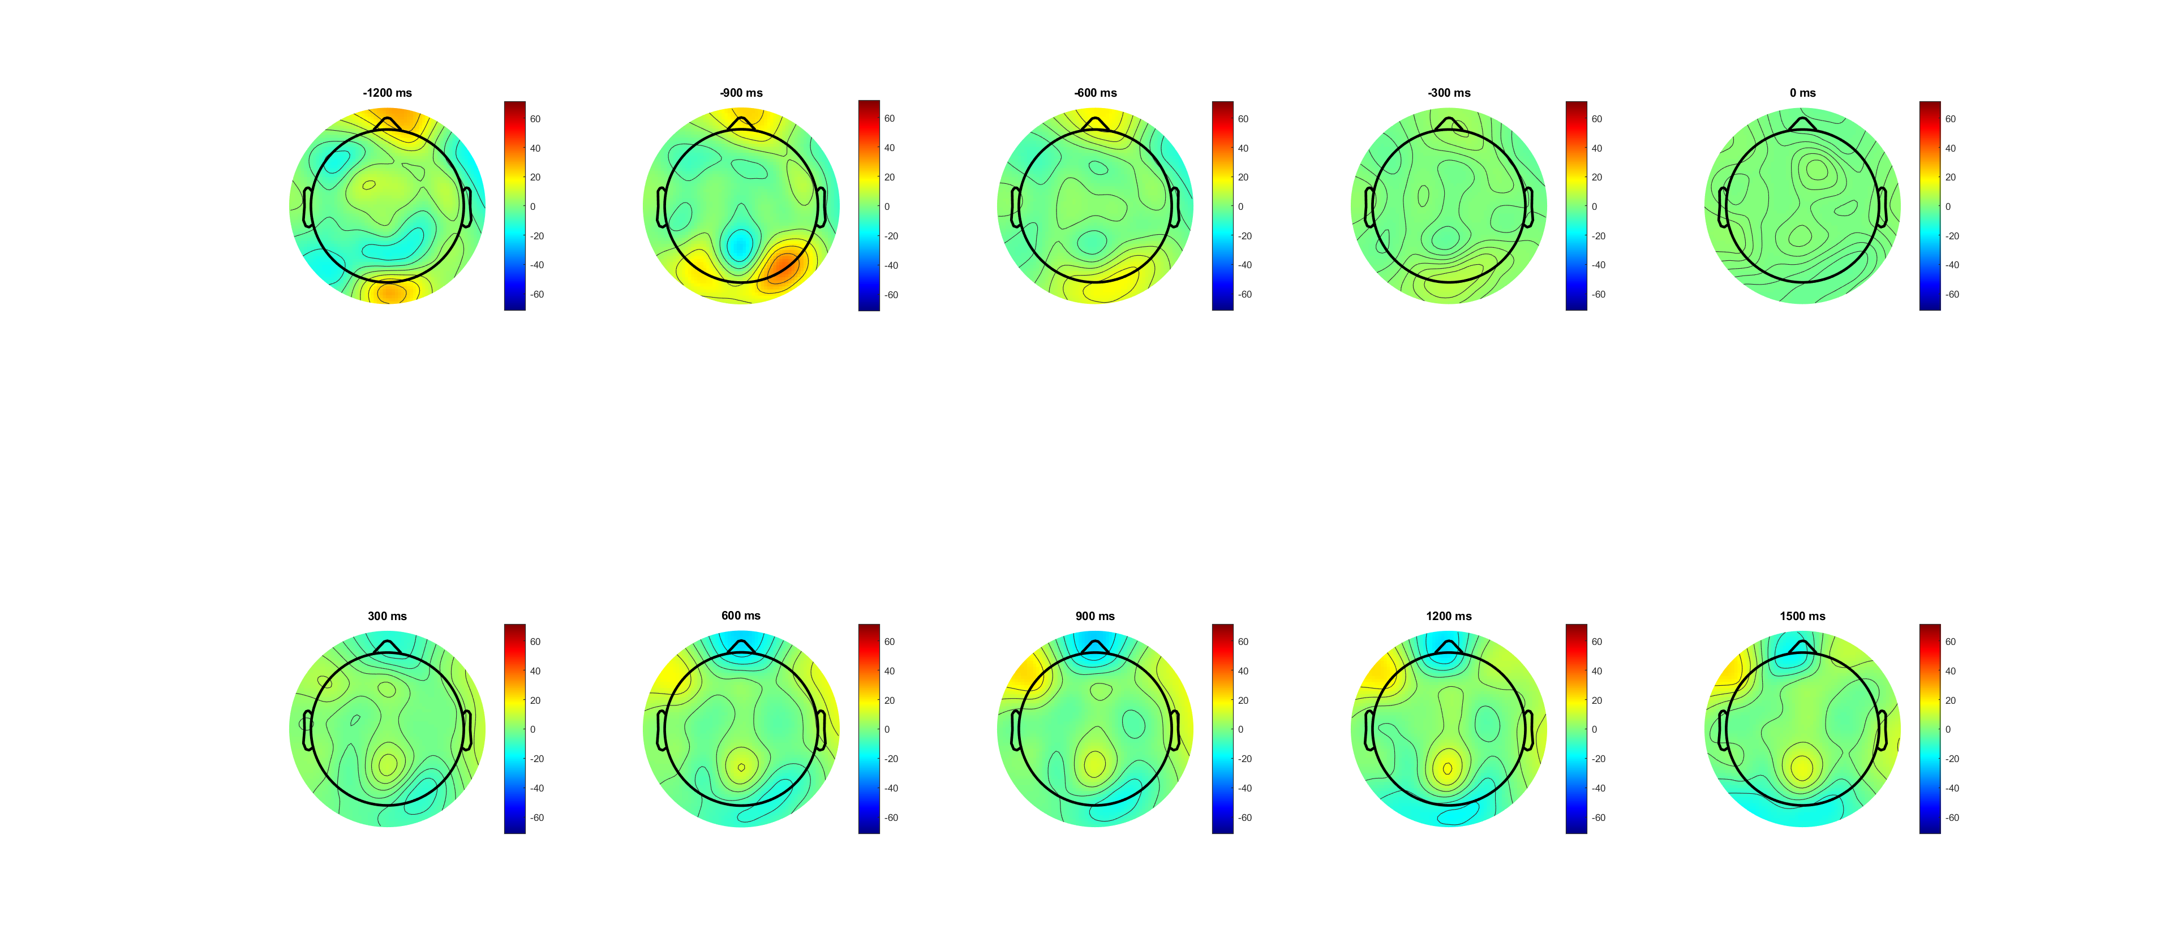
Wrong (-1200:1500) pre evd

Slide 6
Correct Vs wrong(SL pre-cue -188ms) amplitude larger
Drift rate different since ‘evidence on’
After min evidence amplitude drops faster
Lowest at response time
(from scalp plots) correct have clearer CPP burst around 300-900 than wrong
(from scalp plots) same amplitude; but correct CPP moves more to centre from 300-900
Notes:
EEG_sorting_plot_SL_b.m

Slide 7
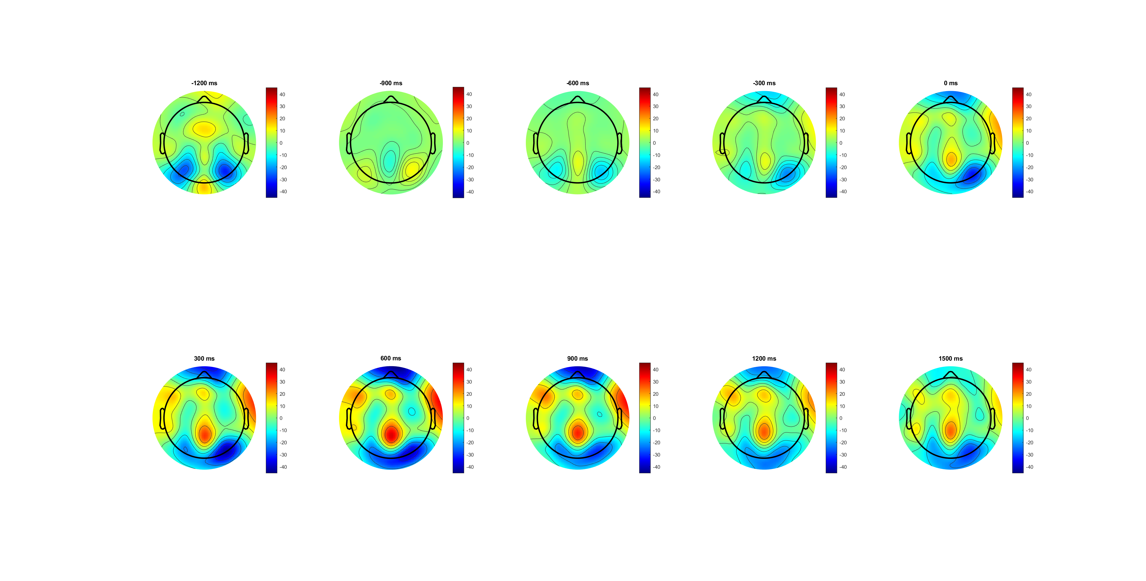
Correct (-1200:1500) pre cue

Slide 8
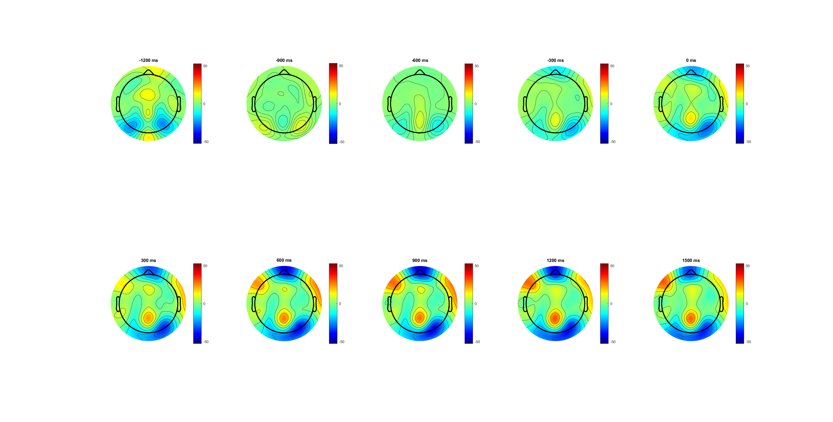
Wrong (-1200:1500) pre cue

Slide 9
High Vs Low(SL_bb)
Low is more like wrong condition
pre-cue baseline (seems already acc before evidence)
(from scalp plots) high is more observious
Notes:
EEG_sorting_plot_SL_bb.m

Slide 10
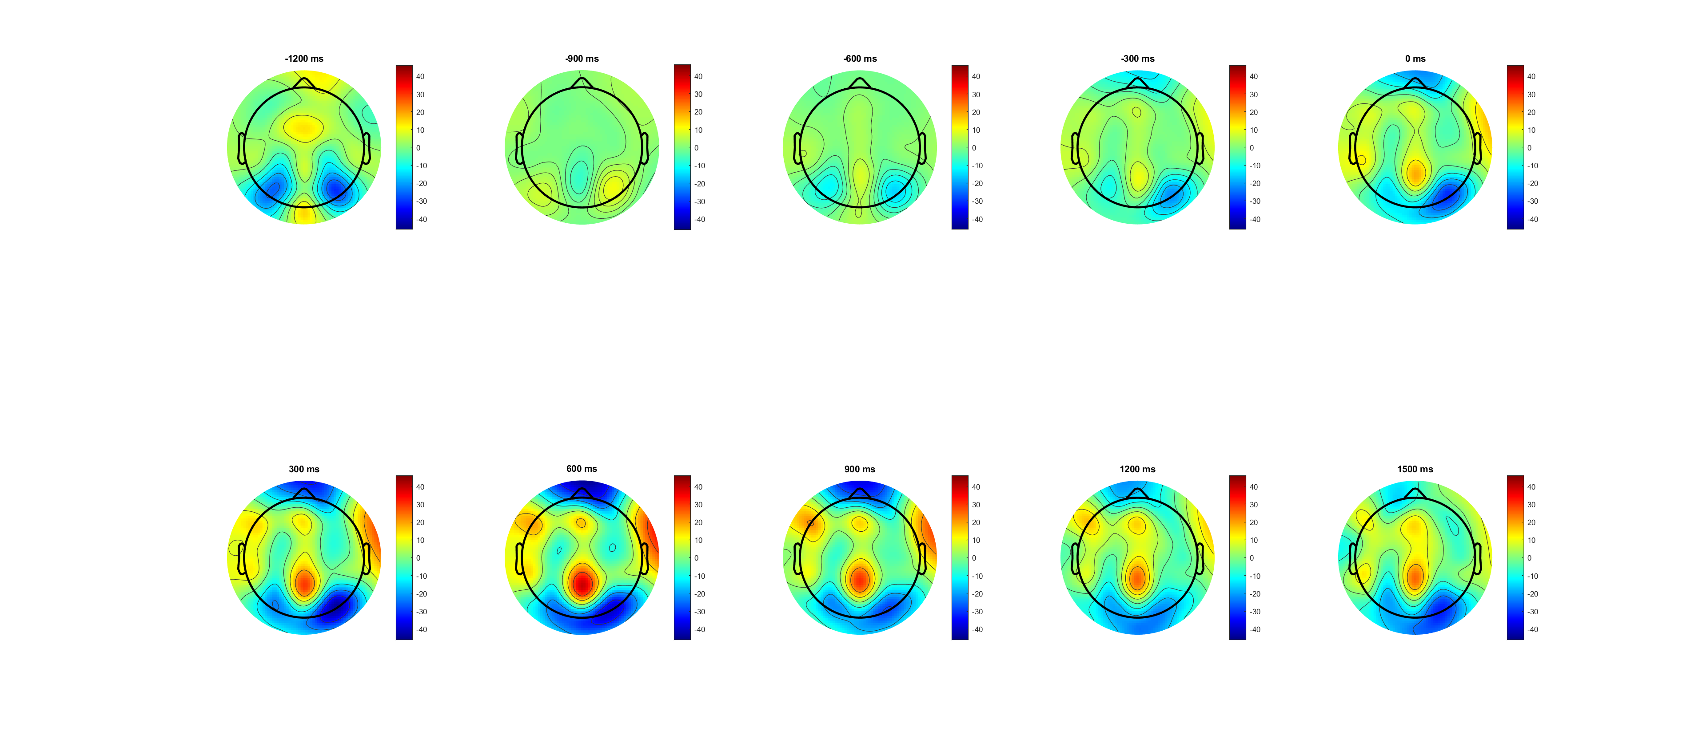
High,0.14 (-1200:1500) pre cue

Slide 11
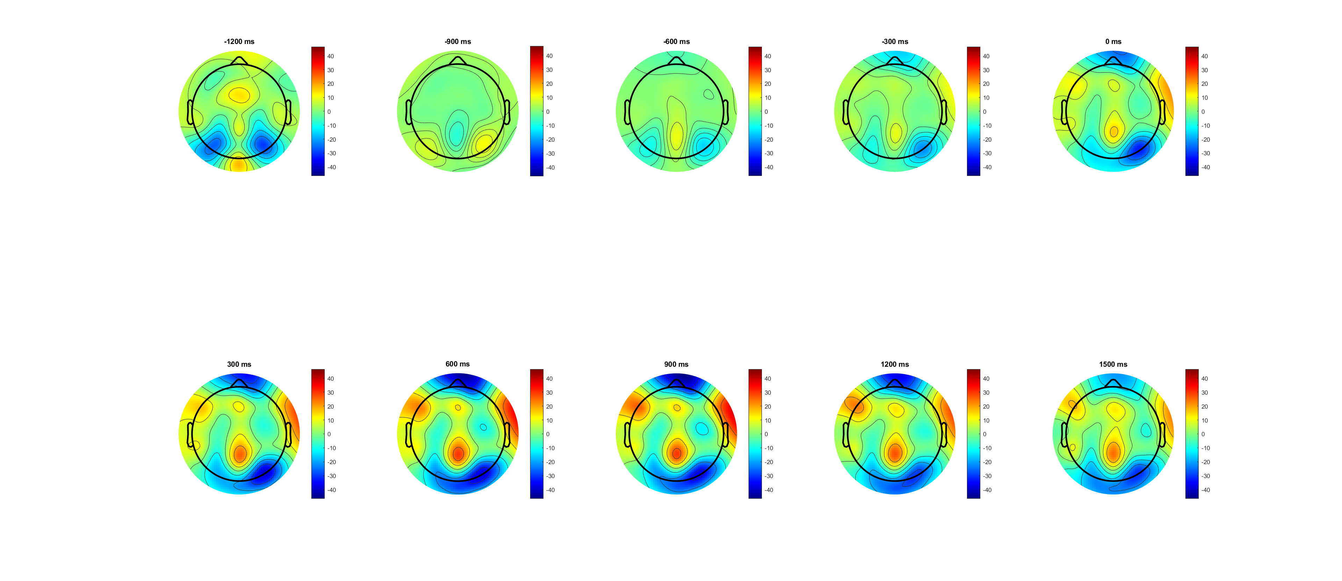
Low,0.07 (-1200:1500) pre cue

Slide 12
High Vs Low(SL_b)
Low is more like wrong condition
Should check in pre-cue baseline (seems already acc before evidence)
(from scalp plots) high is more observious
Notes:
EEG_sorting_plot_SL_b.m

Slide 13
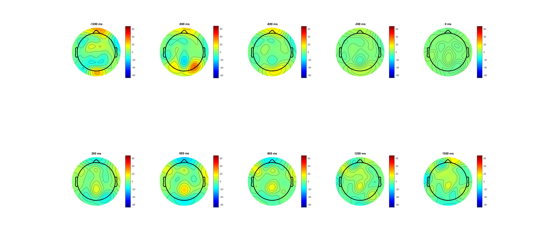
High,0.14 (-1200:1500) pre evidence

Slide 14
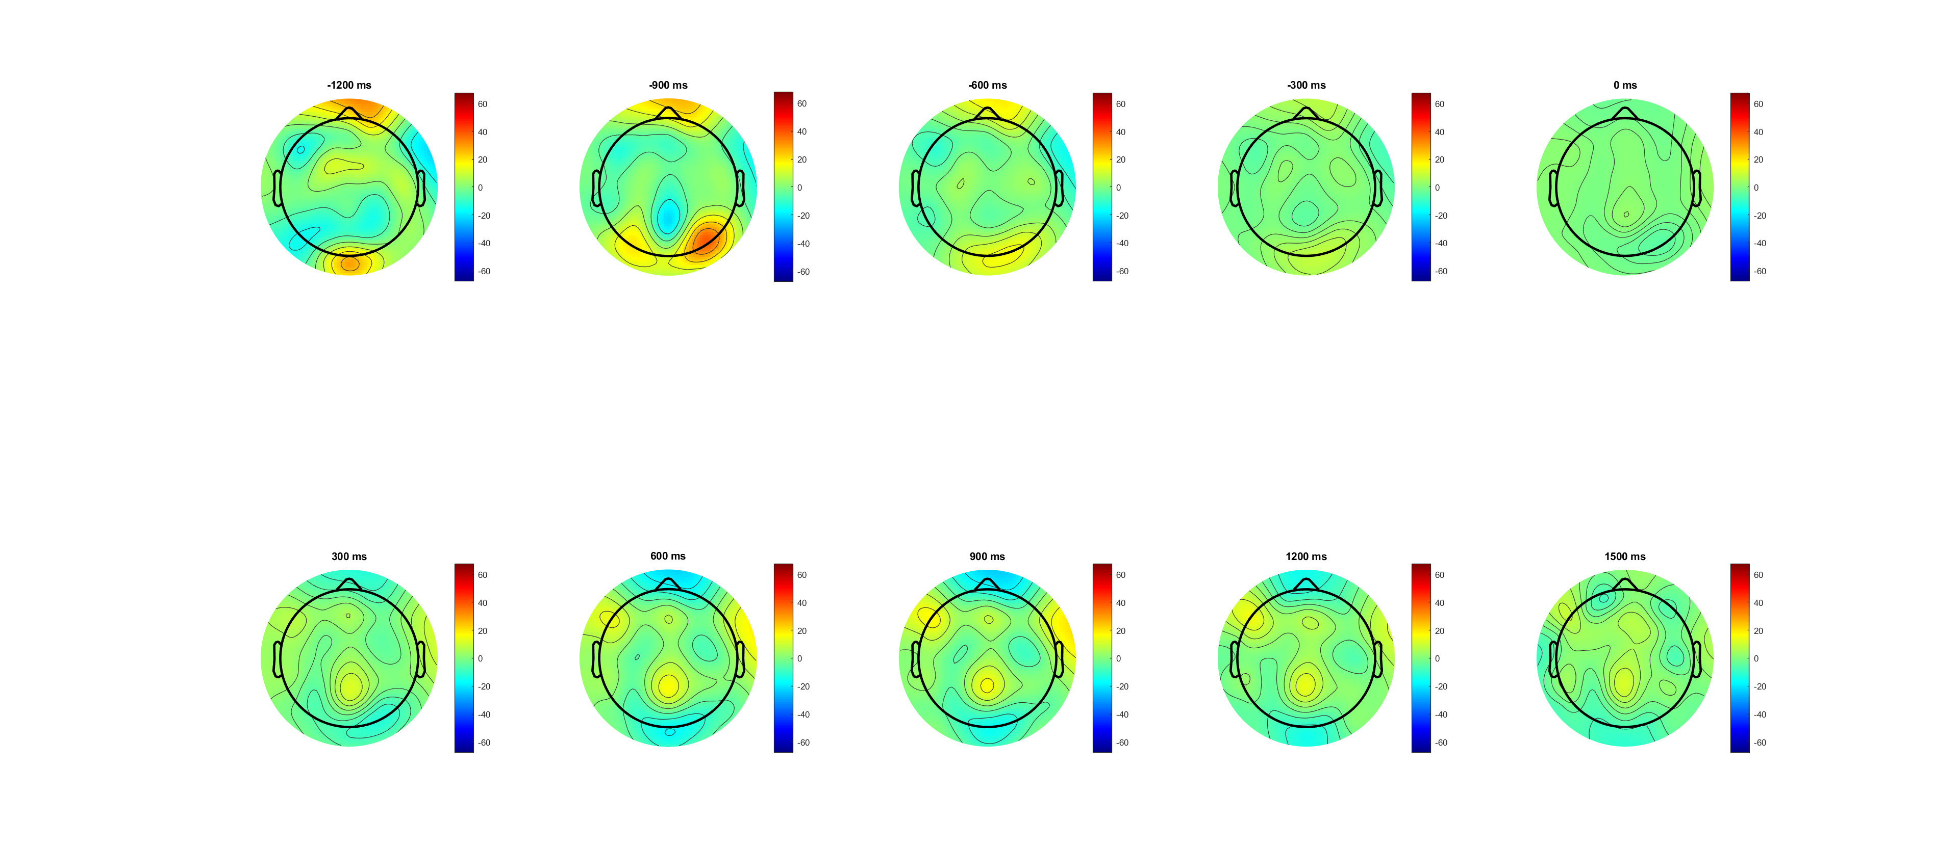
Low,0.07 (-1200:1500) pre evidence

Slide 15
FDI Vs BCP(ERP more clear in pre evidence plot)
Overall BCP lower than FDI!!! But higher between 1.5 and 2
Drift rate slightly different since ‘evidence on’
Lowest at response time
(from scalp plots) FDI slightly stronger!
Notes:
EEG_sorting_plot_SL_b.m

Slide 16
Pre cue
Not observious
Notes:
Pre cue

Slide 17
FDI vs BCP correct(L) wrong(R)
Overall BCP lower than FDI!!!
But higher between 1.5 and 2 (mainly from wrong trials)
Notes:
Pre evidence

Slide 18
FDI vs BCP correct(L) wrong(R)
Overall BCP lower than FDI!!!
But higher between 1.5 and 2 (mainly from wrong trials)
Notes:
Pre cue

Slide 19
FDI vs BCP correct high(0.14 left) low (0.07) right
Among correct trials
The higher FDI in period (0 800) mainly comes from high contrast
The higher FDI in period (800 1500) mainly come from low
Notes:
Pre evd

Slide 20
FDI vs BCP correct high(0.14 left) low (0.07) right
Among correct trials
The higher FDI in period (0 800) mainly comes from high contrast
The higher FDI in period (800 1500) mainly come from low
Notes:
Pre cue

Slide 21
FDI vs BCP wrong high(0.14 left) low (0.07 right)
Among wrong trials (192trial vs 197 trial? Still available?)
BCP always higher in ‘high’ after evidence finish (less Com?)
Notes:
Pre evd

Slide 22
FDI vs BCP wrong high(0.14 left) low (0.07 right)
Among wrong trials (192trial vs 197 trial? Still available?)
BCP always higher in ‘high’ after evidence finish (less Com?)
Notes:
Pre cue

Slide 23
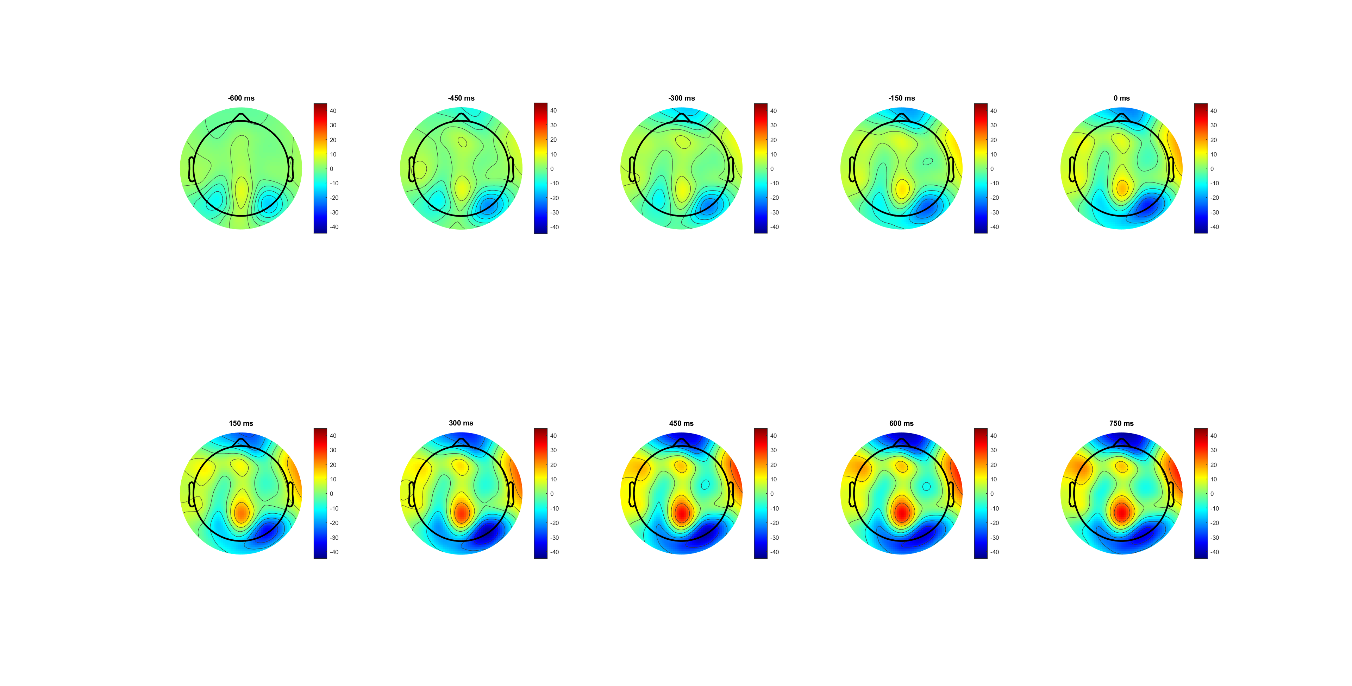
FDI (-600:750) pre cue

Slide 24
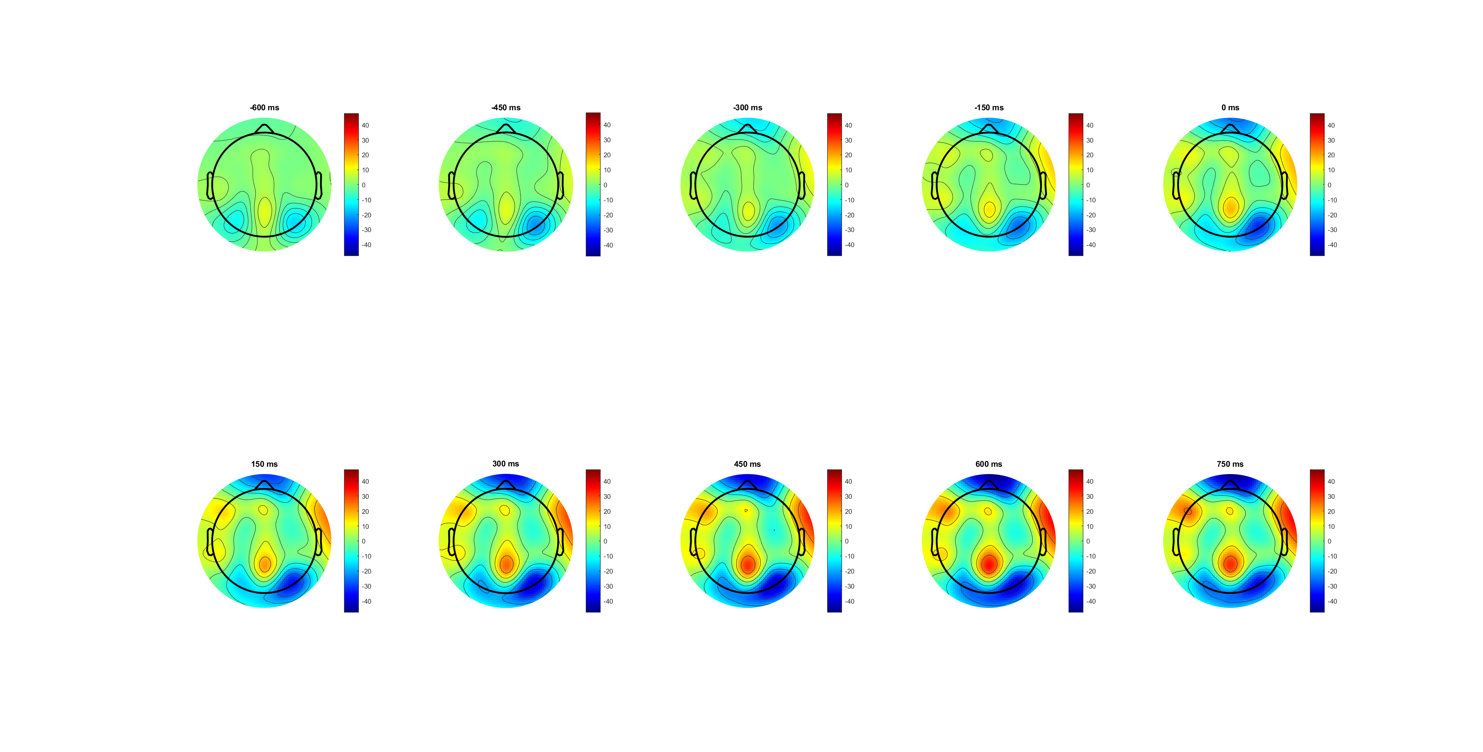
BCP (-600:750) pre cue

Slide 25
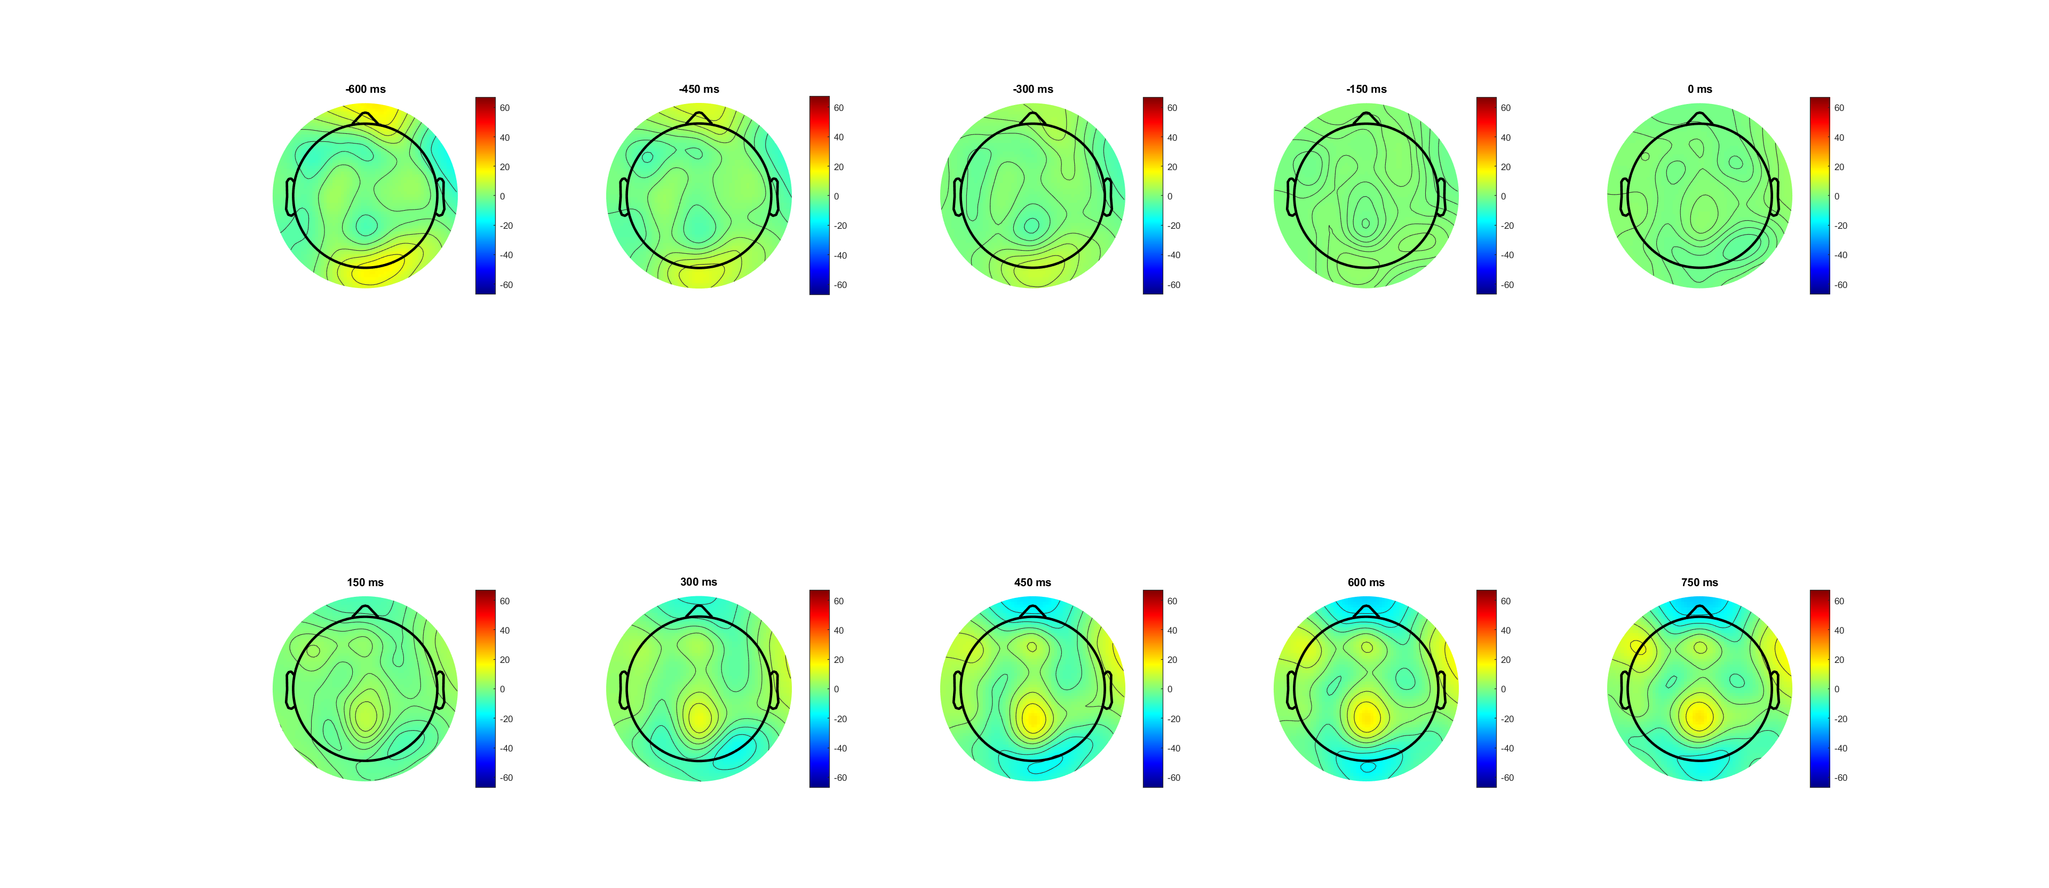
FDI (-600:750) pre evidence

Slide 26
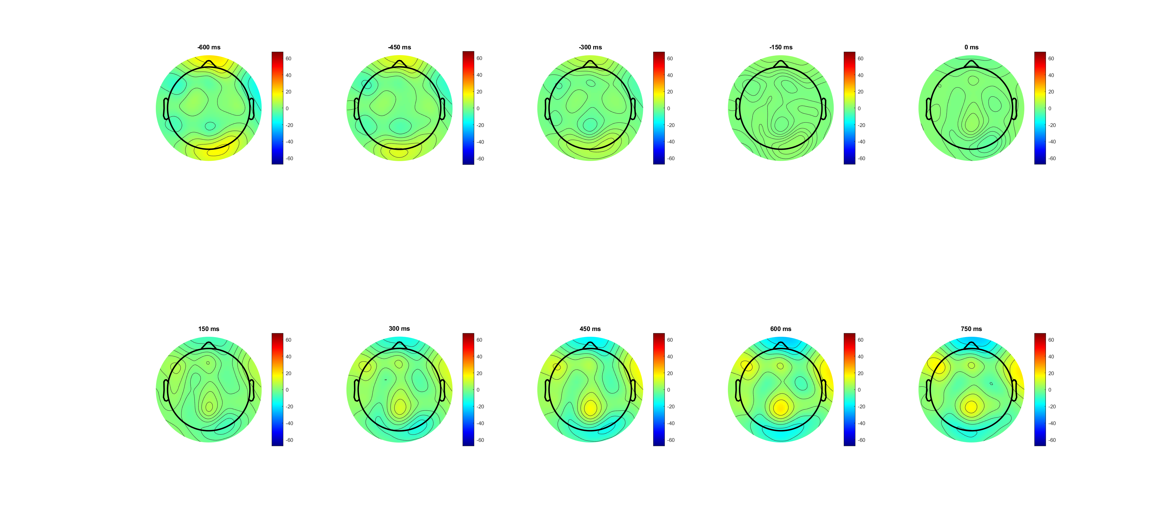
BCP (-600:750) pre evidence

Slide 27
RL_bb pre-response -188ms (FB)
Correct vs wrong
FDI vs BCP
High vs Low

